Slide 1
New York State Mortality Analysis (2018–2023)
Public Health Indicators Dashboard
Prepared for PHIG & Prevention Agenda 2025–2030
Author : Sudha Burla

Slide 2
Project Overview
- Analyzed mortality data in New York (2018–2023)
- Built Tableau dashboards for crude rates & counts
- Applied SAS & Python for cleaning, analysis, visualization
- Produced descriptive epidemiological summaries
- Outputs aligned with Health Assessment 2024 needs

Slide 3
Data Sources
NY Mortality Data (2018–2023)
Annual death counts (ny_mortality_by_year.csv)
Underlying causes of death dataset (Underlying Cause of Death, 2018–2023.csv)
Tools used: SAS, Python, Tableau
Public health context: Mortality, birth data, ACS, hospital discharge, HIV, immunization (future expansion).

Slide 4

Methodology
Step 1: Data Collection
Imported CSV datasets & prepared mortality tables.
Step 2: Data Cleaning
Removed duplicates, handled missing values.
Standardized year & demographic variables.
Step 3: Data Analysis
Calculated crude mortality rate:
Crude Mortality Rate=Total DeathsPopulation×100,000\text{Crude Mortality Rate} = \frac{\text{Total Deaths}}{\text{Population}} \times 100,000Crude Mortality Rate=PopulationTotal Deaths​×100,000
Stratified by year, cause, and race.
Step 4: Visualization
Tableau dashboards (trends & counts).
SAS for structured analysis.
Python (Matplotlib/Seaborn) for reproducible plots.

Slide 5
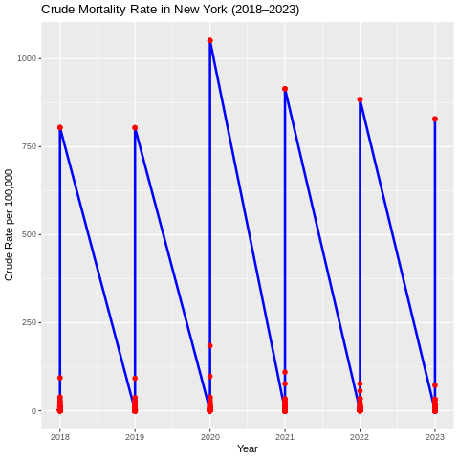
Visualization based on Crude Mortality Rate

Slide 6
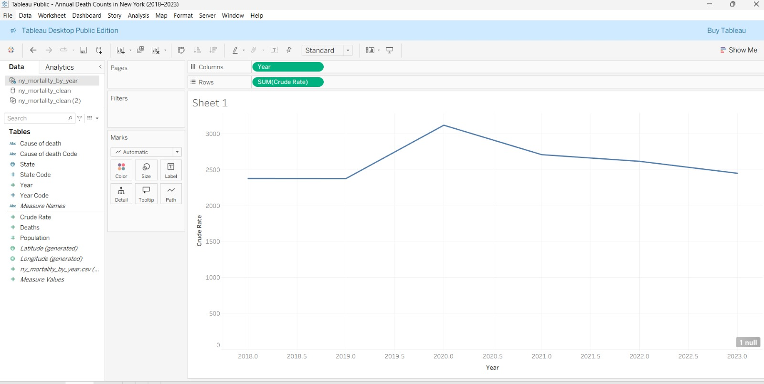
Crude Mortality Rate Trends (2018–2023)

Slide 7
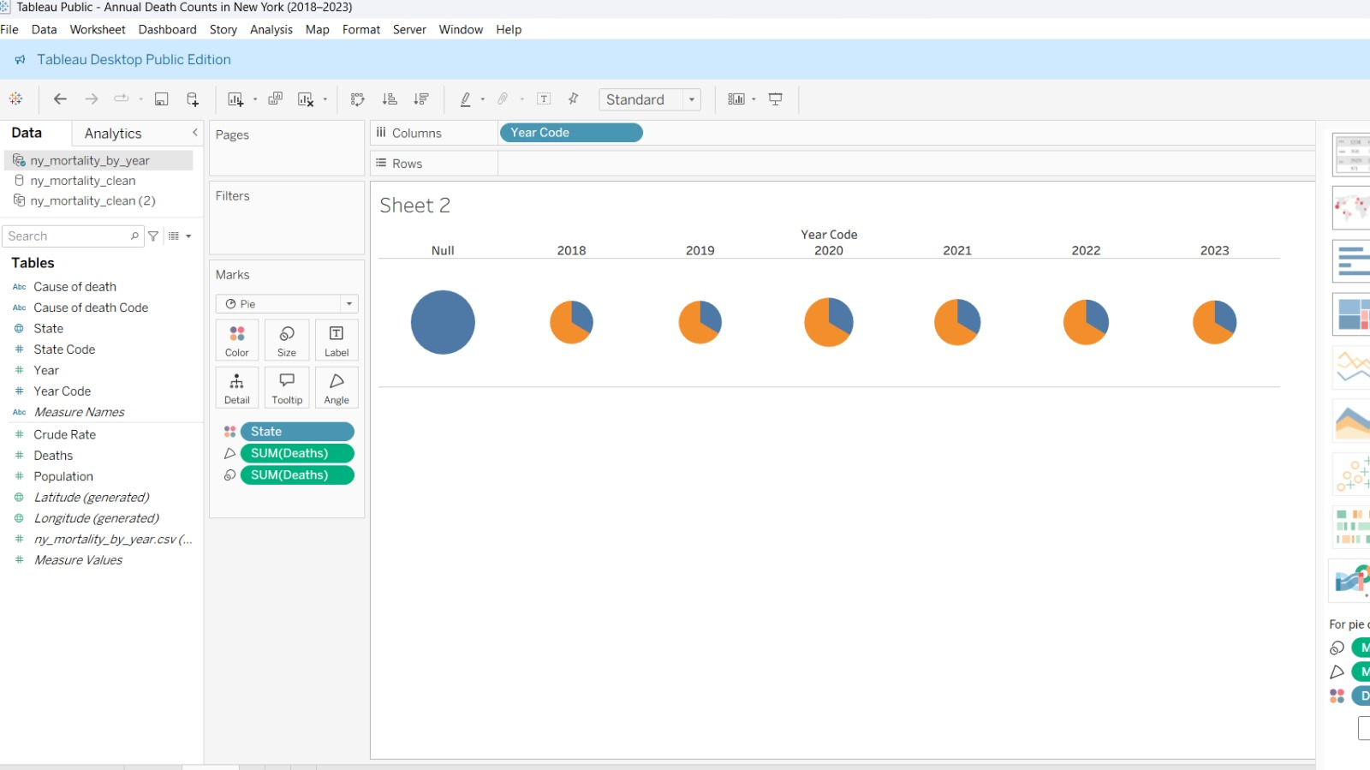
Annual Death Counts in New York

Slide 8
⚙️ Tools & Skills Demonstrated
- SAS: Mortality data cleaning & analysis
- Python: Jupyter, Pandas, Matplotlib, Seaborn
- Tableau: Dashboards for mortality trends
- Epidemiology: Crude rates, population indicators
- Reporting: Health summaries & visual outputs

Slide 9
🚀 Relevance to Public Health
- Supports New York State Health Assessment 2024
- Builds groundwork for Prevention Agenda 2025–2030
- Demonstrates experience with SAS, Tableau, Python
- Provides insights into population health indicators
- Ready-to-integrate outputs for policymakers

Slide 10
Research Implications
Public Health Significance
Provides empirical evidence of mortality trends in New York (2018–2023).
Highlights the impact of COVID-19 on crude death rates.
Informs baseline measures for Health Assessment 2024.

Slide 11

Methodological Contribution
Applied multi-tool approach (SAS, Python, Tableau) for reproducibility.
Integrated data cleaning, statistical analysis, and visualization.
Demonstrated use of epidemiological indicators (crude rates, cause-specific mortality).
Policy & Practice Relevance
Supports the launch of Prevention Agenda 2025–2030 by identifying priority health areas.
Visualizations and summaries can be used in public health surveillance systems.
Findings provide a foundation for future health equity and prevention research.

Slide 12

Thank You

